Slide 1
Topic 6: Trends in Interfaces
SECV2113 Human-Computer Interaction
Faculty of Computing
Universiti Teknologi Malaysia

Slide 2
INTERFACE TYPES
01
NATURAL USER INTERFACES AND BEYOND
02
WHICH INTERFACE?
03

Slide 3
INTERFACE
TYPES

Slide 4
Overview
22 interface types covered
Command
Graphical
Multimedia
Virtual reality
Web
Mobile
Appliance
Voice
Pen
Touch
Touchless
12. Haptic
13. Multimodal
14. Shareable
15. Tangible
16. Augmented reality
17. Wearables
18. Robots and drones
19. Brain-computer
20. Smart
21. Shape-changing
22. Holographic
Provide an overview of the diversity of interfaces
Highlight the main design and research considerations for each of the interfaces

Slide 5
1. Command Line Interfaces
Commands such as abbreviations (for instance, ls) typed in at the prompt to which the system responds (for example, by listing current files)
Some are hard wired at keyboard, while others can be assigned to keys
Efficient, precise, and fast
Large overhead to learning set of commands

Slide 6
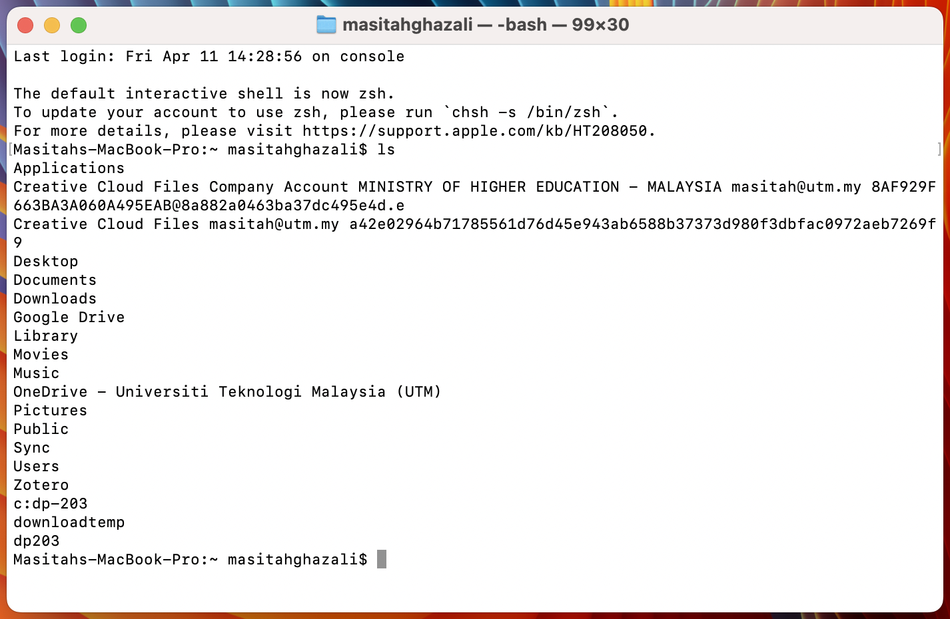
Command ls – lists what is on the laptop drive

Slide 7
Research and Design
Considerations
Form, name types and structure are key research questions
Consistency is most important design principle
For example, always use first letter of command
Command interfaces popular for web scripting and shared document editing (e.g. Overleaf)

Slide 8
2. Graphical User Interfaces (GUIs)
Xerox Star first WIMP gave rise to GUIs
Windows
Sections of the screen that can be scrolled, stretched, overlapped, opened, closed, and moved around the screen using the mouse
Icons
Pictograms that represent applications, objects, commands, and tools that were opened when clicked on
Menus
Lists of options that can be scrolled through and selected
Pointing device
A mouse controlling the cursor as a point of entry to the windows, menus, and icons on the screen

Slide 9
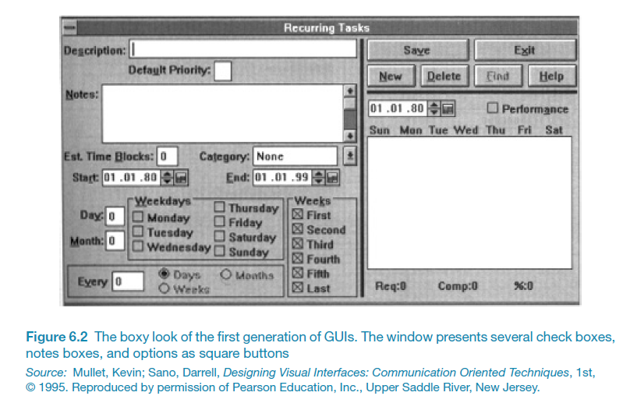
Example of First-Generation GUI

Slide 10
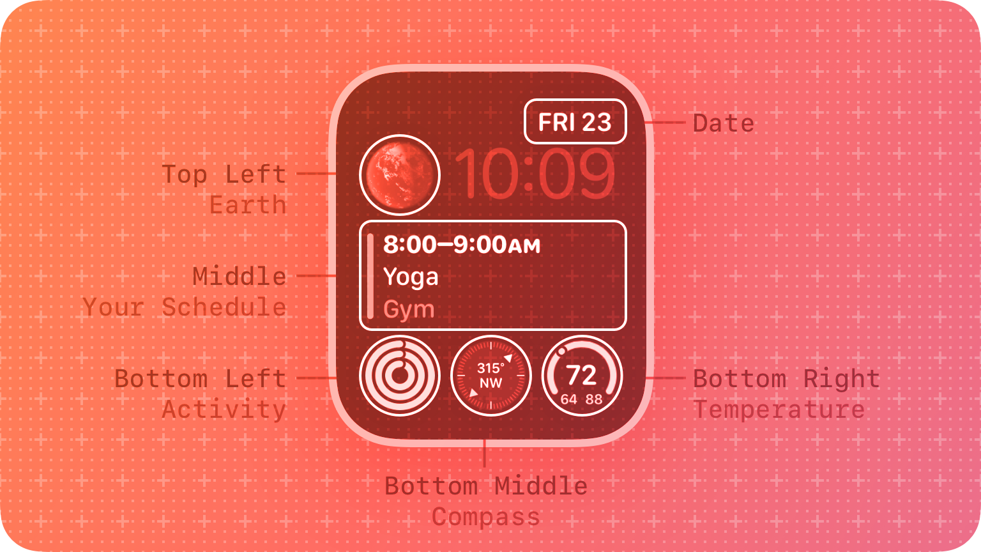
Smartwatch Complication Display
An Apple watchOS complication display that include the features “circulars” (three kinds shown in the bottom line) and “inlines” (shown in the middle and the upper right-hand corner of the display)

Slide 11
Window Design
Windows were invented to overcome the physical constraints of a computer display
They enable more information to be viewed and tasks to be performed
Scroll bars within windows enable more information to be viewed
Multiple windows can make it difficult to find desired one
Listing, tabbing, and thumbnails are techniques that can help

Slide 12
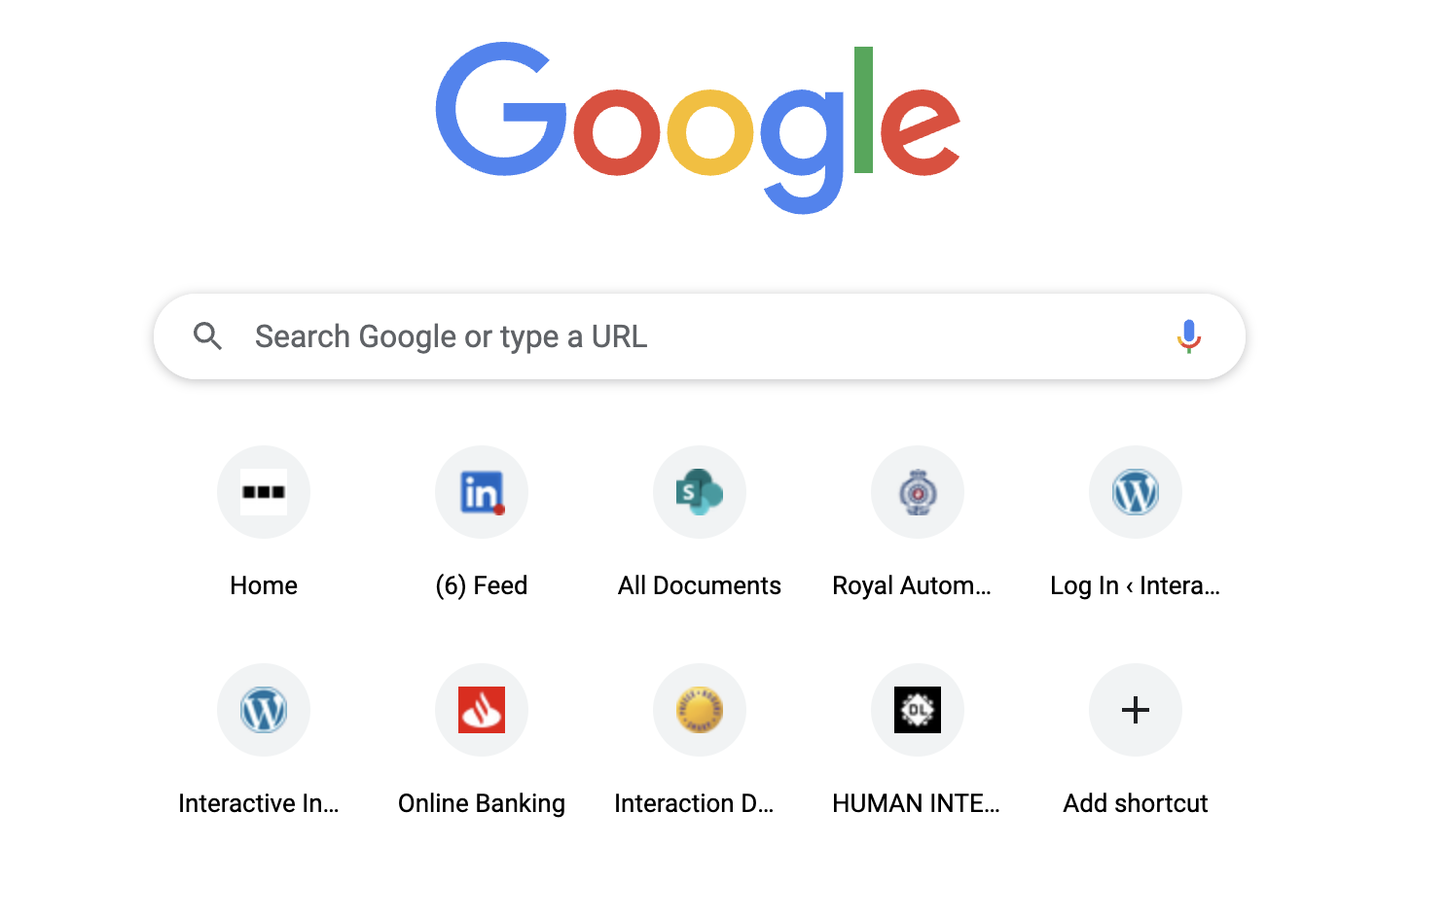
Window Design: favicons of top sites visited below the Google search bar

Slide 13
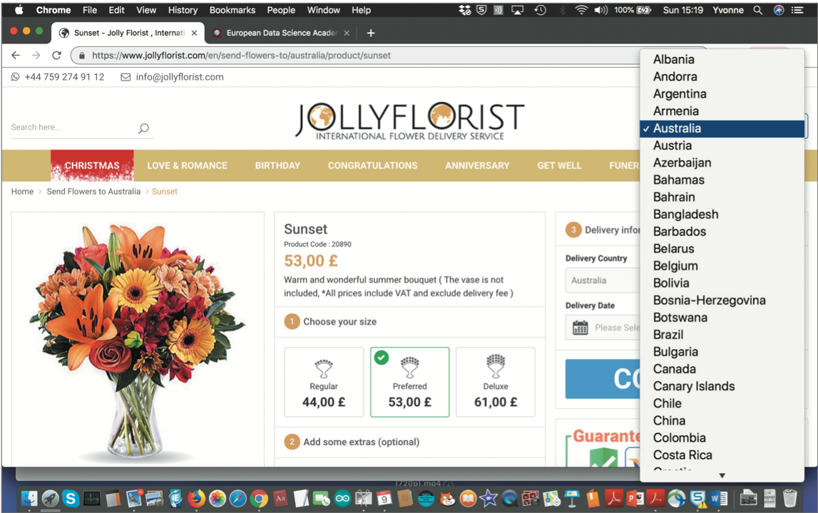
Selecting a country from a scrolling window

Slide 14
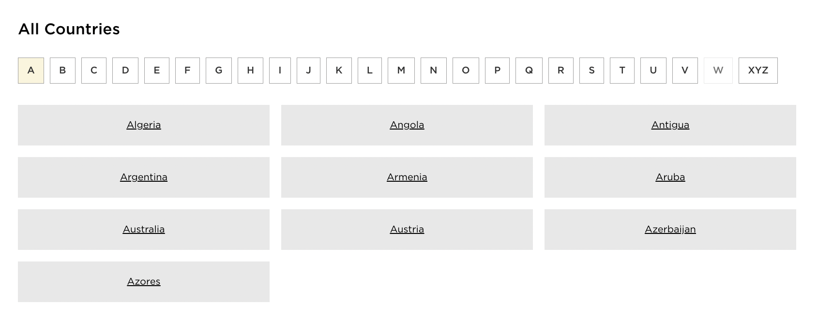
Is this method better? If so, why?

Slide 15
Menu Styles
Flat list: Good for showing large number of options at the same time when display is small
Drop down: Shows more options on same screen (for example, cascading)
Pop-up: When pressed, command key for relevant options
Contextual: Provides access to often-used commands associated with a particular item
Collapsible: Toggles between + and − icons on a header to expand or contract its contents
Mega: All options shown using 2D drop-down layout

Slide 16
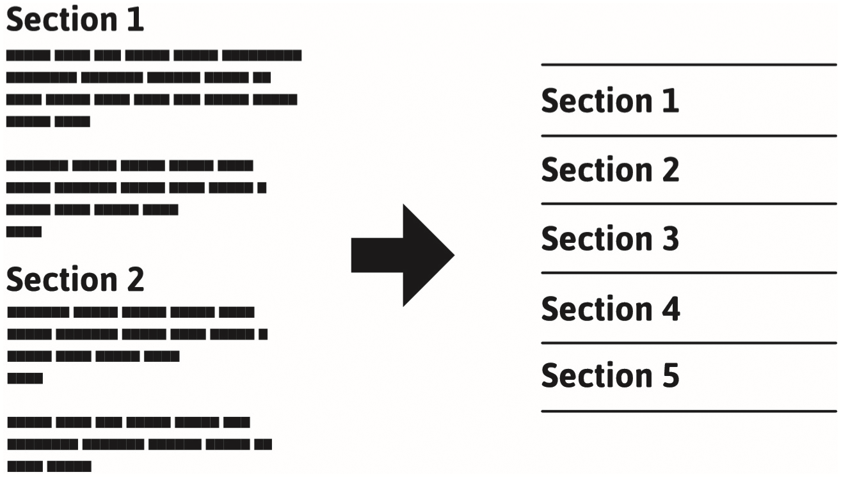
Template for a Collapsible Menu

Slide 17
A Mega Menu

Slide 18
Expanding Menus
Enables more options to be shown on a single screen than is possible with a single flat menu
More flexible navigation, allowing for selection of options to be done in the same window
Most popular are cascading ones
primary, secondary and even tertiary menus
downside is that they require precise mouse control
can result in overshooting or selecting wrong options

Slide 19
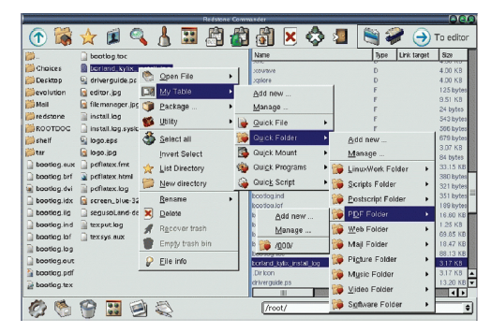
A Cascading Menu

Slide 20
Contextual Menus
Provide access to often-used commands that make sense in the context of a current task
Appear when the user presses the Control key while clicking on an interface element
e.g., clicking on a photo in a website together with holding down the Control key results in options ‘open it in a new window,’ ‘save it,’ or ‘copy it’
Helps overcome some of the navigation problems associated with cascading menus

Slide 21
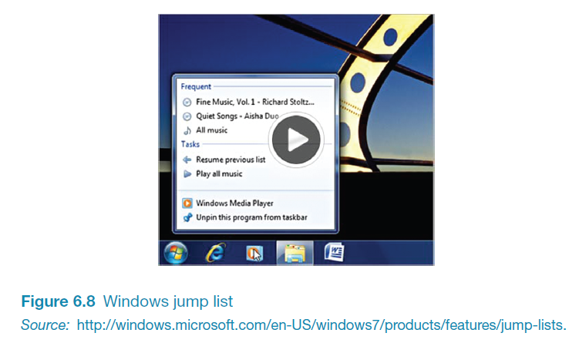
Windows Jump List Menu

Slide 22
Research and Design
Considerations
Window management
Enables users to move fluidly between different windows (and monitors)
How to switch attention between windows without getting distracted
Design principles of spacing, grouping, and simplicity should be used
Which terms to use for menu options (for example, “front” versus “bring to front”
Mega menus easier to navigate than drop-down ones

Slide 23
Icon Design
Icons are assumed to be easier to learn and remember than commands
Icons can be designed to be compact and variably positioned on a screen
Now pervasive in every interface
For example, they represent desktop objects, tools (for example, a paintbrush), applications (for instance, a web browser), and operations (such as cut, paste, next, accept, and change)

Slide 24
Icons
Since the Xerox Star days, icons have changed in their look and feel:
black and white → Color, shadowing, photorealistic images, 3D rendering, animation, flat
Many designed to be very detailed and animated making them both visually attractive and informative
Can be highly inviting, emotionally appealing, and feel alive

Slide 25
Icon Forms
The mapping between the representation and underlying referent can be:
Similar (for example, a picture of a file to represent the object file)
Analogical (for instance, a picture of a pair of scissors to represent ‘cut’)
Arbitrary (such as the use of an X to represent ‘delete’)
The most effective icons are similar ones
Many operations are actions making it more difficult to represent them
Use a combination of objects and symbols that capture the salient part of an action

Slide 26
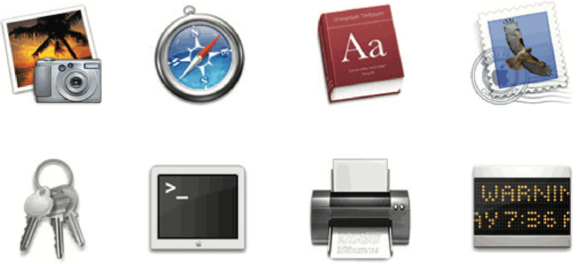
2 types of Apple Aqua icon styles

Slide 27
Flat 2D icons for a smartphone and a smartwatch

Slide 28

Activity
Sketch simple icons to represent the following operations to appear on a digital camera screen:
Turn image 90-degrees sideways
Crop the image
Auto-enhance the image
Show them to someone else and see if they can understand what each represents

Slide 29
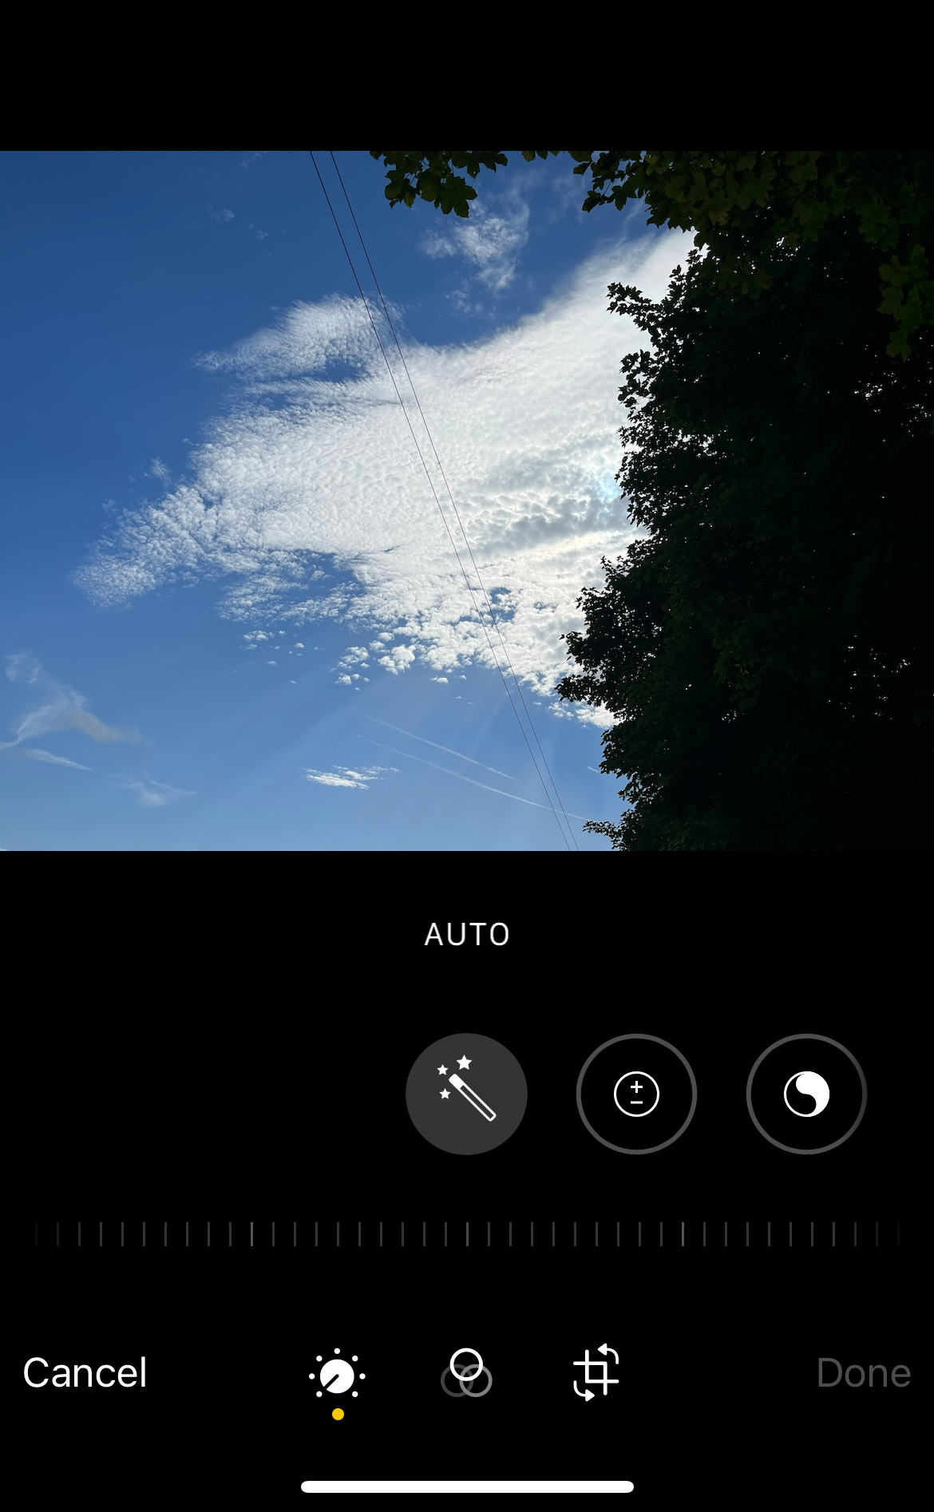
Basic edit icons that appear on the iPhone app
The box with extended lines and two arrows is the icon for cropping an image
the three overlapping translucent circles represents “different lenses” that can be used
the wand above means “auto-enhance
the circle with plus and minus signs refers to exposure levels
the circle to the right of it with the simplified ying and yang symbol refers to brilliance levels

Slide 30
Research and Design
Considerations
There is a wealth of resources for creating icons
Guidelines, style guides, icon builders, libraries, online tutorials
Text labels can be used alongside icons to help identification for small icon sets
For large icon sets (for instance, photo editing or word processing) can use the hover function

Slide 31
3. Multimedia
Combines different media within a single interface with various forms of interactivity
Graphics, text, video, sound, and animation
Users click on links in an image or text
Another part of the program
An animation or a video clip is played
Users can return to where they were or move on to another place
Can provide better ways of presenting information than a single media can

Slide 32
Pros and Cons
Facilitates rapid access to multiple representations of information
Can provide better ways of presenting information than can any media alone
Can enable easier learning, better understanding, more engagement, and more pleasure
Can encourage users to explore different parts of a game or story
Tendency to play video clips and animations while skimming through accompanying text or diagrams

Slide 33
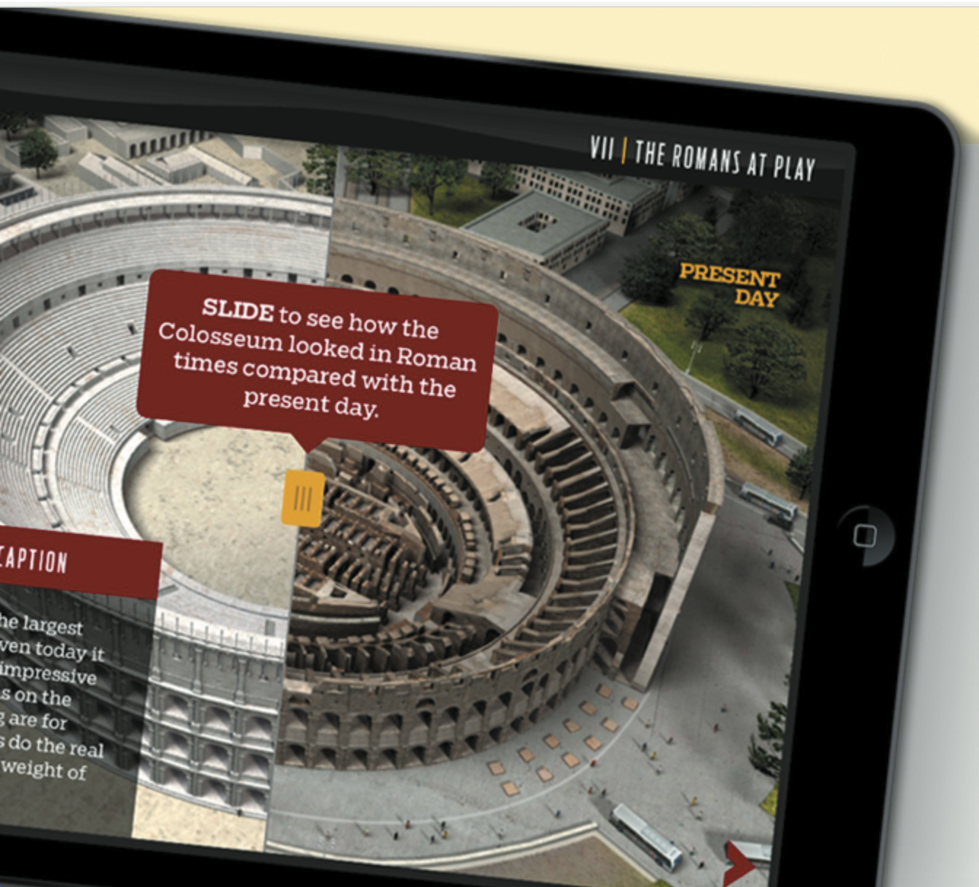
Multimedia learning app designed for tablet

Slide 34
Research and Design
Considerations
How to design multimedia to help users explore, keep track of, and integrate the multiple representations
Provide hands-on interactivities and simulations that the user has to complete to solve a task
Provide quizzes, electronic notebooks, and games
Multimedia good for supporting certain activities, such as browsing, but less optimal for reading at length

Slide 35
4. Virtual Reality
Computer-generated graphical simulations providing:
“the illusion of participation in a synthetic environment rather than external observation of such an environment” (Gigante, 1993)
Provide new kinds of experience, enabling users to interact with objects and navigate in 3D space
Create highly-engaging user experiences

Slide 36
Pros and Cons
Can have a higher level of fidelity with objects that they represent compared to multimedia
Induces a sense of presence where someone is totally engrossed by the experience
“a state of consciousness, the (psychological) sense of being in the virtual environment” (Slater and Wilbur, 1999)
Provides different viewpoints: first and third person
Early head-mounted displays were uncomfortable to wear and could cause motion sickness and disorientation
Lighter VR headsets are now available (for example, HTC Vive) with more accurate head tracking

Slide 37
Examples
Video games
Arcade games for social groups
Well being and therapy for fears
Experience how others feel emotions
For example, empathy and compassion
Enrich user’s planning experience for travel destinations
Architecture, design, and education

Slide 38
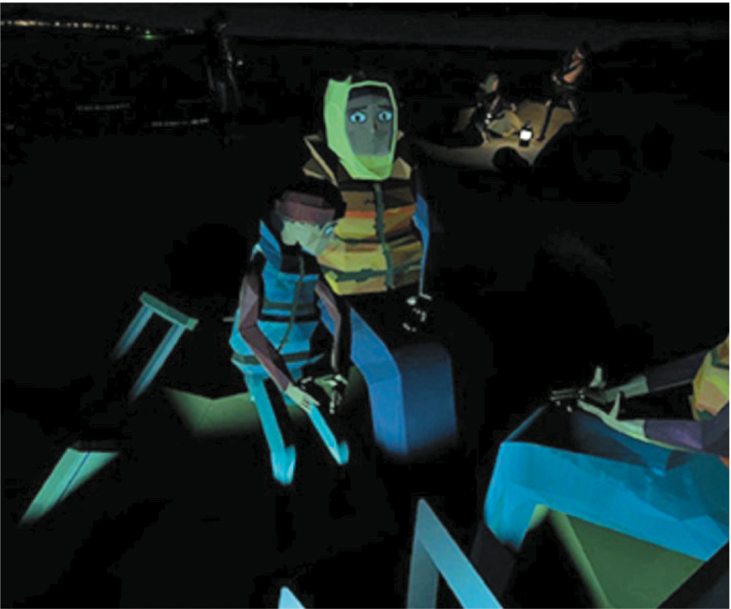
Polygon graphics used to represent avatars for the We Wait VR experience

Slide 39
UTM Classroom of the Future
Offshore experience
Source: https://magicx.my/classroom-of-the-future/

Slide 40
Research and Design
Considerations
Much research on how to design safe and realistic VRs to facilitate training
For example, flying simulators
Help people overcome phobias (for example, spiders or talking in public)
Design issues
How best to navigate through them (for instance, first versus third person)
How to control interactions and movements (for example, by using head and body movements)
How best to interact with information (for instance by using keypads, controllers, pointing, and joystick buttons)
Level of realism to aim for to engender a sense of presence

Slide 41
5. Web
Early websites were largely text-based, providing hyperlinks
Focus was on how best to structure information to enable users to navigate and access them easily and quickly
Nowadays, more emphasis is on making pages distinctive, striking, and aesthetically pleasing
Need to think of how to design information for different platforms—keyboard or touch?
For example, smartphones, tablets, and PCs

Slide 42
Usability versus Aesthetics
Vanilla or multi-flavor design?
Ease of finding something versus aesthetic and enjoyable experience
Web designers are:
“thinking great literature”
Users read the web like a:
“billboard going by at 60 miles an hour” (Krug, 2014)
Need to determine how to brand a web page to catch and keep ‘eyeballs’

Slide 43
Breadcrumbs for Navigation
Breadcrumbs are category labels:
Enable users to look at other pages without losing track of where they have come from
Very usable
Enable one-click access to higher site levels
Attract first time visitors to continue to browse a website having viewed the landing page

Slide 44
Web Design Styles
Responsive website design
the browser automatically resizes the layout, and changes the graphic design, fonts, and appearance depending on the screen size (smartphone, tablet, or PC) on which it is being displayed.
downsizing the content in this way makes it more time-consuming as more pages need to be loaded.
can also make it more fiddly navigating multiple pages and menus
Infinite scrolling
websites are designed to enable browsing content on one long page
avoids a visitor needing to wait for pages to load when clicking on them
navigation is largely done by swiping across or down the page until the end is reached
a side effect is the tendency to glance while scrolling without focusing on individual items

Slide 45
In-your-face Web Ads
Web advertising is often intrusive and pervasive
Flashing, aggressive, persistent, and annoying
Often requires action to get rid of
What is the alternative?
Use of ad blockers

Slide 46
Research and Design
Considerations
Many books and guidelines on website design
Veen’s (2001) three core questions to consider when designing any website:
Where am I?
Where can I go?
What’s here?

Slide 47
Activity
Look at a fashion brand’s website, for example, Nike.com or Levis
What kind of website is it?
How does it contravene the design principles outlined by Veen?
Does it matter?
What kind of user experience is it providing for?
What was your experience of engaging with it?

Slide 48
6. Mobile
Handheld devices intended to be used while on the move
Have become pervasive, increasingly used in all aspects of everyday and working life
For example, phones, fitness trackers, and smartwatches
Larger-sized tablets used in mobile settings
Including those used by flight attendants, marketing professionals, and at car rental returns

Slide 49
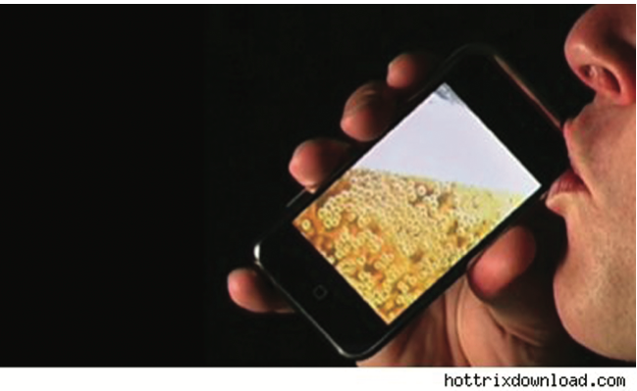
The Advent of the iPhone App
A whole new user experience that was designed primarily for people to enjoy
many apps not designed for any need, want or use but purely for idle moments to have some fun
e.g. iBeer developed by magician Steve Sheraton
ingenious use of the accelerometer that is inside the phone

Slide 50
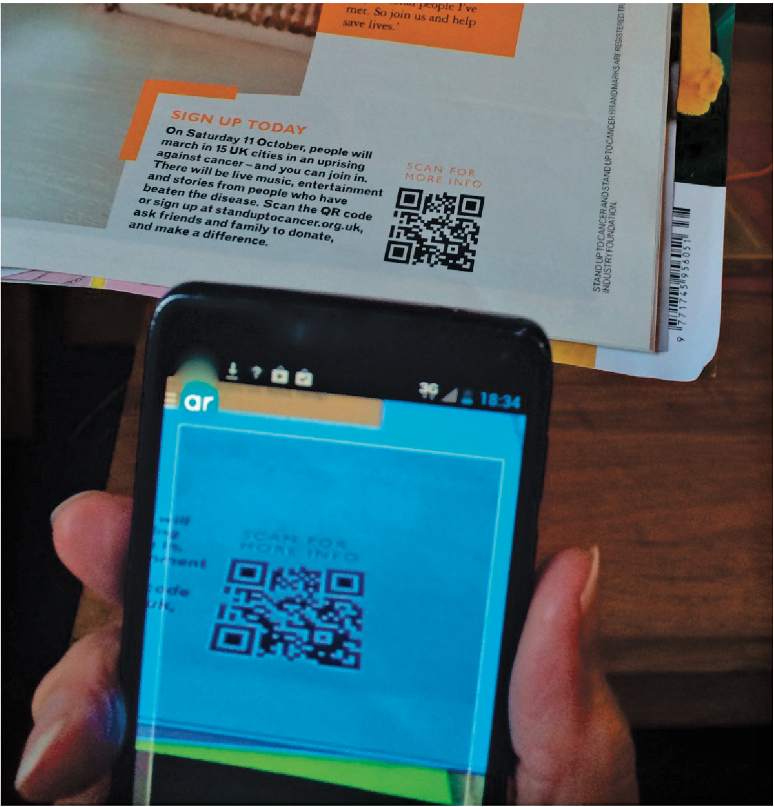
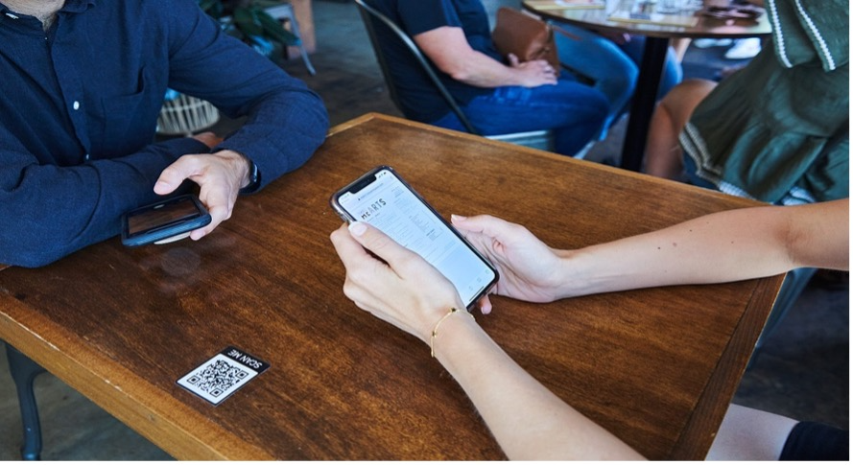
QR Codes and Smartphones

Slide 51
Mobile Challenges
Smaller screens, small number of physical keys and restricted number of controls
Innovative physical designs including:
roller wheels, rocker dials, up/down ‘lips’ on the face of phones, 2-way and 4-way directional keypads, softkeys, silk-screened buttons
Usability and preference varies
depends on the dexterity and commitment of the user
Smartphones overcome mobile physical constraints through using multi-touch displays

Slide 52
Research and Design
Considerations
Mobile interfaces can be cumbersome to use for those with poor manual dexterity or ‘fat’ fingers
Key concern is hit area:
Area on the phone display that the user touches to make something happen, such as a key, an icon, a button, or an app
Space needs to be big enough for all fingers to press accurately
If too small, the user may accidentally press the wrong key
Fitts’ law can be used to help design right spacing
Minimum tappable areas should be 44 points x 44 points for all controls

Slide 53
7. Appliances
Everyday devices in home, public places, or car
For example, washing machines, remotes, toasters, printers, and navigation systems)
And personal devices
For instance, digital clock and digital camera
Used for short periods
For example, starting the washing machine, watching a program, buying a ticket, changing the time, or taking a snapshot
Need to be usable with minimal, if any, learning

Slide 54
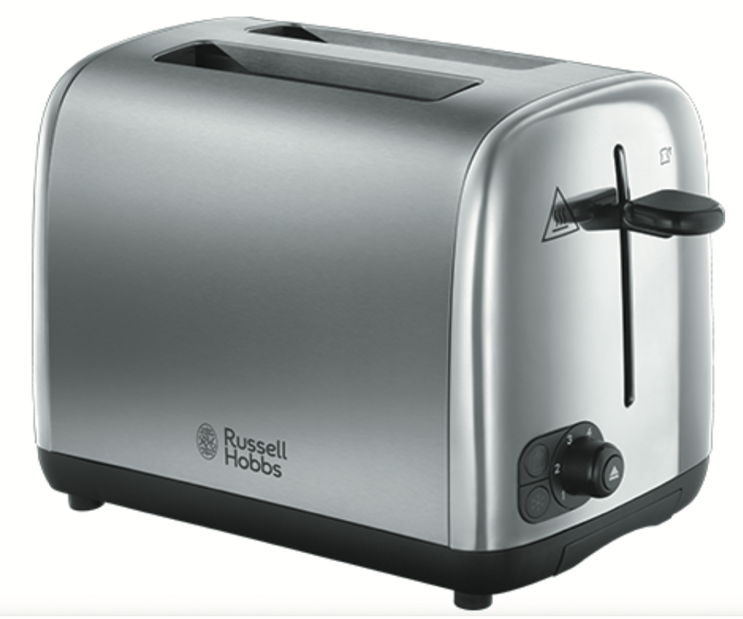
Simple Toaster Control

Slide 55
Research and Design
Considerations
Need to design as transient interfaces with short interactions
Simple interfaces
Consider trade-off between soft and hard controls
e.g. buttons or keys, dials or scrolling
Understand the innate human ability to manipulate physicality (Ghazali and Dix)
The relationship between the physical controllers with the digital underlying functionalities

Slide 56
8. Voice
Involves a person talking with a spoken language app, for example, timetable, travel planner, or phone service or chatbots
Used mainly for inquiring about specific information, for example, flight times or to perform a transaction, such as buying a ticket
Mostly a voice system is reactive responding to a person’s queries
Also used by people with visual impairments
For example, speech recognition word processors, page scanners, web readers, and home control systems

Slide 57
Have speech interfaces come of age?

Slide 58
Modelling Human Conversations
People often interrupt each other in a conversation
Especially when ordering in a restaurant, rather than let the waiter go through all of the options
Speech technology has a similar feature called ‘barge-in’
Users can choose an option before the system has finished listing all of the options available

Slide 59
Structuring Voice Dialogs
Directed dialogs are where the system is in control of the conversation
Where it asks specific questions and requires specific responses
More flexible systems allow the user to take the initiative:
For example, “I’d like to go to Paris next Monday for two weeks.”
Guided prompts can help callers back on track
For example, “Sorry I did not get all that. Did you say you wanted to fly next Monday?”

Slide 60
Voice Assistants (for e.g. Alexa)
Allow all to use rather than being single use
Support families playing games, interactive storytelling, jokes, and so forth
Can encourage social and emotional bonding
Young children (under 4), however, find it difficult to be understood by the voice assistants
Frustrating for them

Slide 61
Research and Design
Considerations
How to design systems that can keep conversation on track
Help people navigate efficiently through a menu system
Enable them to recover easily from errors
Guide those who are vague or ambiguous in their requests for information or services
Type of voice actor (for example, male, female, neutral, or dialect)
Do people prefer to listen to and are more patient with a female or male voice, a northern or southern accent?

Slide 62
9. Pen-based Devices
Enable people to write, draw, select, and move objects at an interface using light pens or styluses
Capitalise on the well-honed drawing skills developed from childhood
Smartpens use a combination of ordinary ink pen with digital camera that digitally records everything written with the pen on special paper

Slide 63
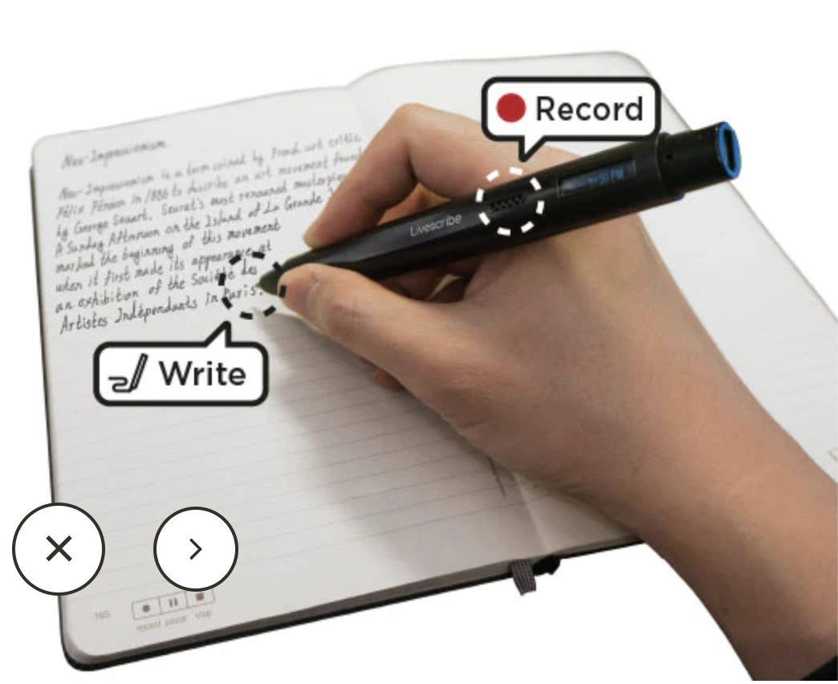
The LiveScribe Echo 2 Smartpen

Slide 64
Pros and Cons
Allows people to annotate existing documents quickly and easily
Can be used to fill in paper-based forms that can readily be converted to a digital record using standard typeface
Can be used by remote teams to communicate and work on the same documents
Can be difficult to see options on the screen because a user’s hand can occlude part of it when writing
Can have lag and feel clunky

Slide 65
10. Touchscreens
Single touchscreens are used in walk-up kiosks (such as ticket machines and ATMs) to detect the presence and location of a person’s touch on the display
Multi-touch surfaces support a range of more dynamic finger tip actions, for example, swiping, flicking, pinching, pushing, and tapping
They do so by registering touches at multiple locations using a grid
Now used for many kinds of displays, such as smartphones, iPods, tablets, and tabletops
Supports one and two hand gestures, including tapping, zooming, stretching, flicking, dwelling, and dragging

Slide 66
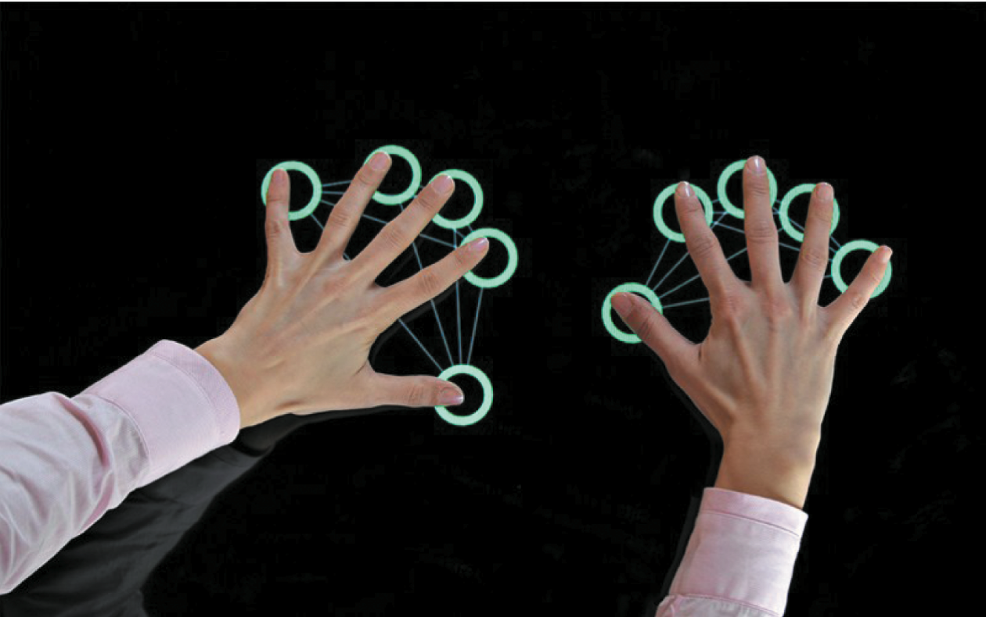
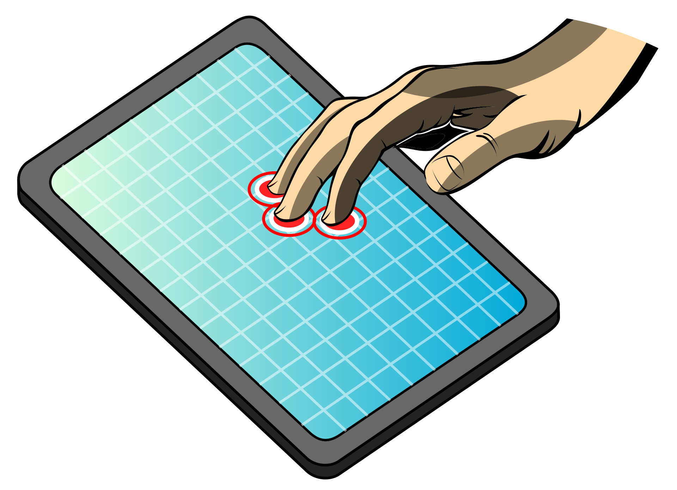
A Multi-touch Surface

Slide 67
Research and Design
Considerations
Provides fluid and direct styles of interaction involving freehand and pen-based gestures for certain tasks
Core design concerns include whether size, orientation, and shape of touch displays effect collaboration
Much faster to scroll through wheels, carousels, and bars of thumbnail images or lists of options by finger flicking
Gestures need to be learned for multi-touch, so a small set of gestures for common commands is preferable
More cumbersome, error-prone, and slower to type using a virtual keyboard on a touch display than using a physical keyboard

Slide 68
11. Touchless
Gestures involve moving arms and hands to communicate
Uses camera recognition, sensor, and computer vision techniques
Recognise people’s arm and hand gestures in a room
Gestures need to be presented sequentially to be understood (compare with the way sentences are constructed)

Slide 69
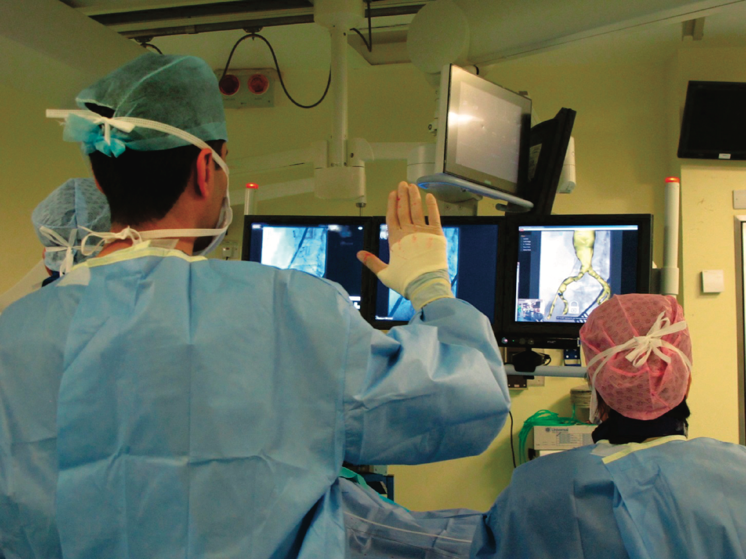
Touchless interface in the operating theater
Recognises core gestures for manipulating MRI or CT images using Microsoft Kinect

Slide 70
Entertainment (public space)
MaGICX Johor Port 2015
Source: https://magicx.my/

Slide 71
Car Dashboards using Gestures
BMW’s iDrive enables drivers to control certain functions with the use of hand gestures captured by a 3D camera
e.g. turning up or down the audio volume, For audio control these comprise of rotating the index finger clockwise (up) or anti-clockwise (down)
Gesture control sensors are also positioned in the roof lining of the car
To ensure they are safe, the gestures were developed and tested in the simulator

Slide 72
Research and Design
Considerations
How does computer recognize and delineate user’s gestures?
Start and end points?
Difference between deictic and hand waving
How realistic must the mirrored graphical representation of the user be in order for them to be believable?

Slide 73
12. Haptic
Provide tactile feedback
By applying vibration and forces to a person’s body, using actuators that are embedded in their clothing or a device they are carrying, such as a smartphone
Vibrotactile feedback can be used to simulate the sense of touch between remote people who want to communicate
Ultrahaptics creates the illusion of touch in midair using ultrasound to make the illusion of 3D shapes

Slide 74
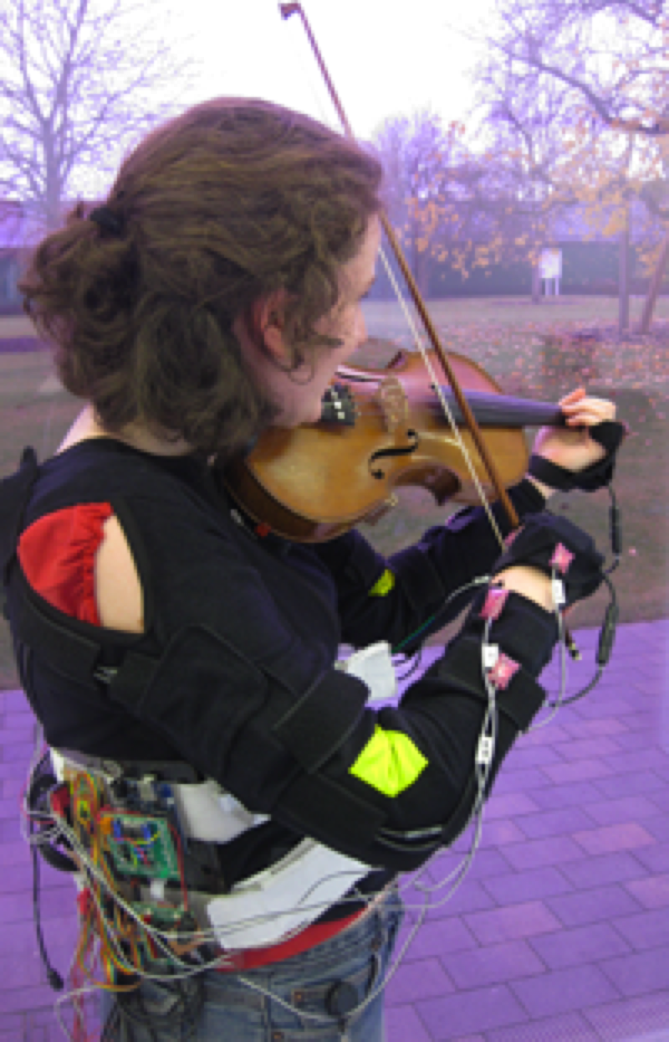
Realtime Vibrotactile Feedback
Provides nudges when playing violin incorrectly
Uses motion capture to sense arm movements that deviate from model
Nudges are short vibrations on arms and hands

Slide 75
Exoskeleton with artificial muscles that uses bubble haptic feedback

Slide 76
Research and Design
Considerations
Where best to place actuators on body
Whether to use single or sequence of ‘touches’
When to buzz and how intense
How does the wearer feel it in different contexts?
What kind of new smartphone/smartwatch apps can use vibrotactile creatively?
For example, slow tapping to feel like water drops meant to indicate that it is about to rain, and heavy tapping to indicate a thunderstorm is looming

Slide 77
13. Multimodal Interfaces
Provide enriched user experiences
By multiplying how information is experienced and detected using different modalities, such as touch, sight, sound, and speech
Support more flexible, efficient, and expressive means of human-computer interaction
Most common combination is speech and vision
Can be combined with multi-sensor input to enable other aspects of the human body to be tracked
For example, eye gaze, facial expression, and lip movements
Provides input for customising user interfaces

Slide 78
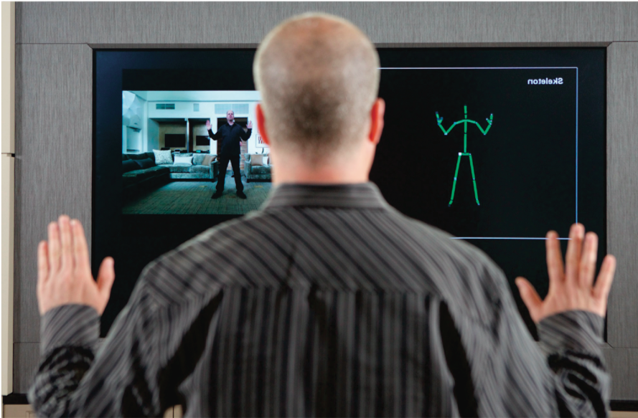
Tracking a person’s movement
Kinect camera can detect multimodal input in real time using RGA camera for facial recognition and gestures, depth camera for movement tracking, and microphones for voice recognition
Used to build model of person and represented as avatar on display programmed to move just like them

Slide 79
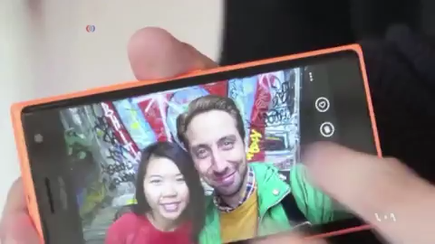
Sending modalities via smartphone
Send taste, smell, touch via smartphone: https://learningenglish.voanews.com/a/smartphones-may-be-able-to-send-tastes-smeel-touches/2634824.html

Slide 80
Research and Design
Considerations
Need to recognise and analyse user behavior, for example, speech, gesture, handwriting, or eye gaze
Much harder to calibrate these than single modality systems
What is gained from combining different input and outputs
Is talking and gesturing, as humans do with other humans, a natural way of interacting with a computer?

Slide 81
14. Shareable Interfaces
Designed for more than one person to use:
Provide multiple inputs and sometimes allow simultaneous input by co-located groups
Large wall displays where people use their own pens or gestures
Interactive tabletops where small groups interact with information using their fingertips
For example, DiamondTouch, Smart Table, and Surface

Slide 82
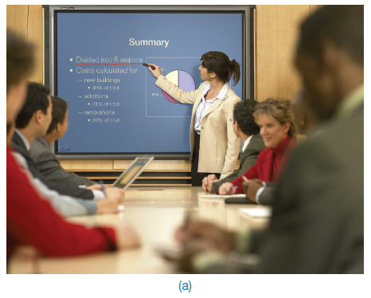
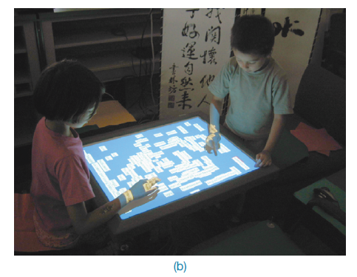
A smartboard and an interactive tabletop interface

Slide 83
Benefits
Provide a large interactional space that can support flexible group working
Can be used by multiple users
Can point to and touch information being displayed
Simultaneously view the interactions and have the same shared point of reference as others
Can support more equitable participation compared with groups using single PC

Slide 84
Research and Design
Considerations
Core design concerns include whether size, orientation, and shape of the display have an effect on collaboration
Horizontal surfaces compared with vertical ones support more turn-taking and collaborative working in co-located groups
Providing larger-sized tabletops does not improve group working but encourages more division of labor
Having both personal and shared spaces enables groups to work on their own and in a group
A design challenge is how to bridge across devices, applications and time such that the peoples’ interactions are seamless

Slide 85
15. Tangible Interfaces
Type of sensor-based interaction, where physical objects, for example, bricks, are coupled with digital representations
When a person manipulates the physical object/s, it causes a digital effect to occur, for example, an animation
Digital effects can take place in a number of media and places, or they can be embedded in the physical object

Slide 86
Examples
Flow Blocks
Depict changing numbers and lights embedded in the blocks
Vary depending on how they are connected together
Urp
Physical models of buildings moved around on tabletop
Used in combination with tokens for wind and shadows → Digital shadows surrounding them to change over time
MagicCubes
Connect physical electronic components and sensors to make digital events occur (for example, change color depending on how much shaken)

Slide 87
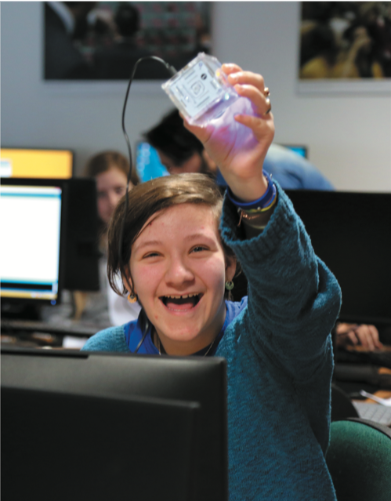
Learning to code and create with the tangible MagicCubes

Slide 88
Benefits
Can be held in one or both hands and combined and manipulated in ways not possible using other interfaces
Allows for more than one person to explore the interface together
Objects can be placed on top of each other, beside each other, and inside each other
Encourages different ways of representing and exploring a problem space
People are able to see and understand situations differently
Can lead to greater insight, learning, and problem-solving than with other kinds of interfaces
Can facilitate creativity and reflection

Slide 89
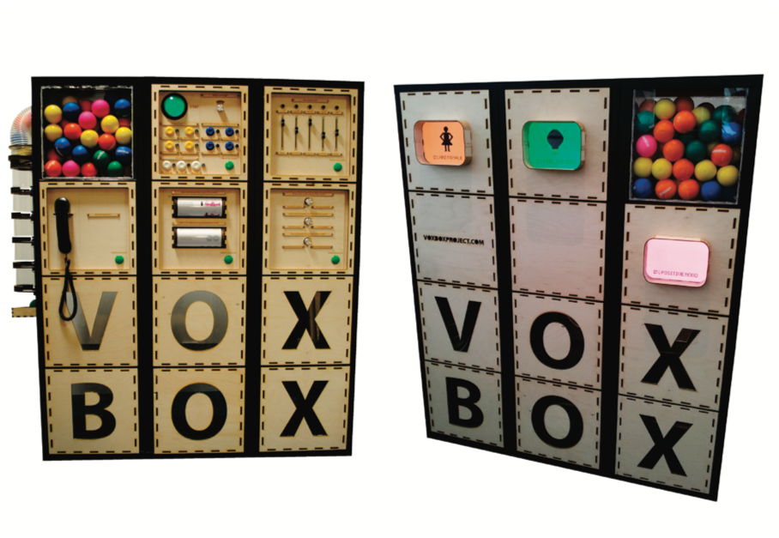
VoxBox
A tangible system that gathers opinions at events through playful and engaging interaction (Goldsteijn et al., 2015)

Slide 90
Research and Design
Considerations
What kinds of conceptual frameworks to use to help identify novel and specific features
What kind of coupling to use between the physical action and digital effect
If it is to support learning, then an explicit mapping between action and effect is critical
If it is for entertainment, then it can be better to design it to be more implicit and unexpected
What kind of physical artifact to use
Bricks, cubes, and other component sets are most commonly used because of flexibility and simplicity
Stickies and cardboard tokens can also be used for placing material onto a surface
With what kinds of digital outputs should tangible interfaces be combined?

Slide 91
16. Augmented Reality
Digital representations are superimposed on physical objects or the environment
Pokémon Go made it a household game
Used smartphone camera and GPS to place virtual characters onto objects in the environment as if they really are there
Many other applications including medicine, navigation, air traffic control, games, and everyday exploring

Slide 92
Other Examples
In medicine
Virtual objects, for example, x-rays and scans, are overlaid on part of a patient’s body
Aid the physician’s understanding of what is being examined or operated
In air traffic control
Dynamic information about aircraft overlaid on a video screen showing the real planes, and so on landing, taking off, and taxiing
Helps identify planes difficult to make out

Slide 93
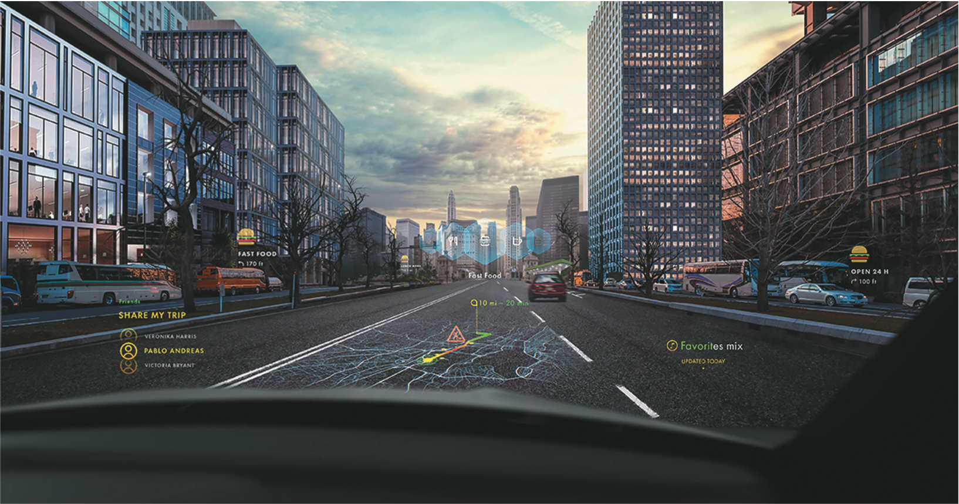
Augmented reality overlay on a car windshield

Slide 94
Devices for Viewing AR
AR can be viewed through headsets, smartphones and glasses (e.g., SnapChat’s AR spectacles).
Headsets can provide a more immersive experience, but the downside is they are cumbersome to wear and fiddly to calibrate
Convenient and easy-to-wear AR glasses are beginning to appear

Slide 95
Mobile AR BoboiBoy

Slide 96
AR that uses forward facing camera
Enables virtual try-ons (for example, Snapchat filters, Zoom filters)
AT mirrors set up in retail stores for trying on make-up, sunglasses, jewelry
Convenient, engaging, and easy to compare more choices
But cannot feel the weight, texture, or smell of what is being tried on
Can be used to enable users to step into a character (for example, David Bowie, Queen Victoria)

Slide 97
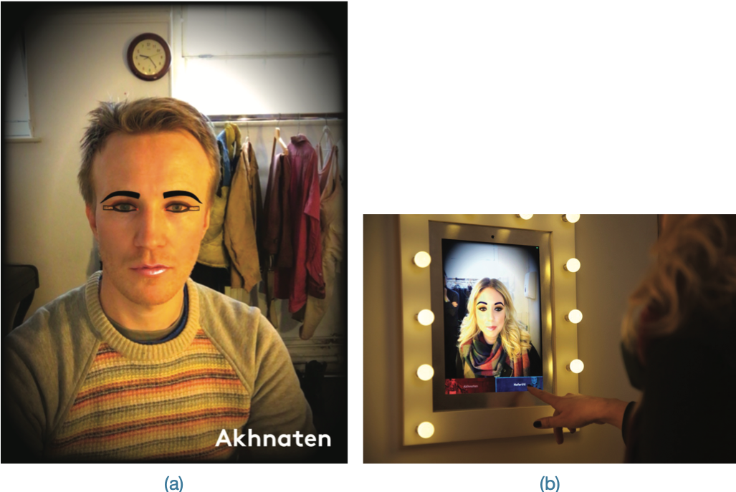
Singers trying on the virtual look of two characters from the opera Akhnaten

Slide 98
Research and Design
Considerations
What kind of digital augmentation?
When and where in physical environment?
Needs to stand out but not distract from ongoing task
Needs to be able to align with real world objects
What happens if the AR is slightly off?
What kind of device?
Smartphone, tablet, head up display or other?

Slide 99
17. Wearables
First developments were head- and eyewear-mounted cameras that enabled user to record what was seen and to access digital information
Since then, jewelry, head-mounted caps, smart fabrics, glasses, shoes, and jackets have all been used
Provides the user with a means of interacting with digital information while on the move
Applications include automatic diaries, tour guides, cycle indicators, and fashion clothing

Slide 100
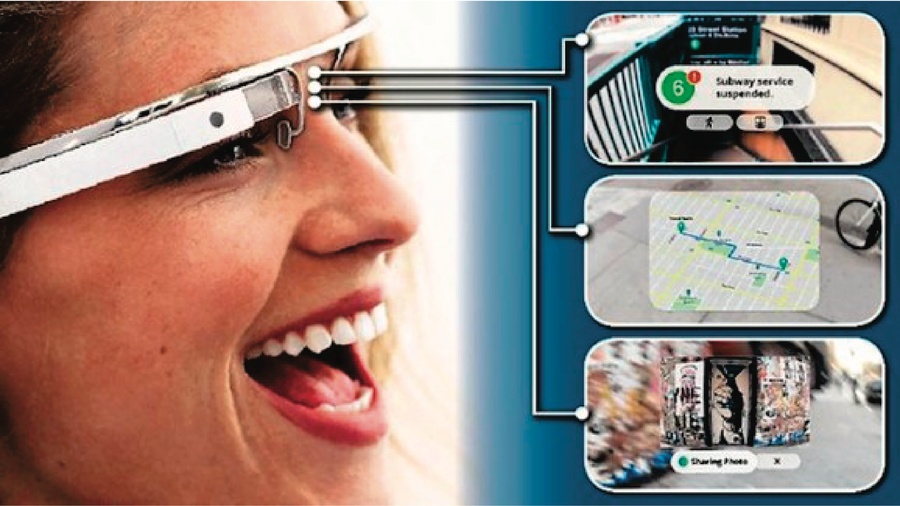
Google Glass (2014)
Why was there so much excitement and concern about people filming what they could see right in front of them?

Slide 101
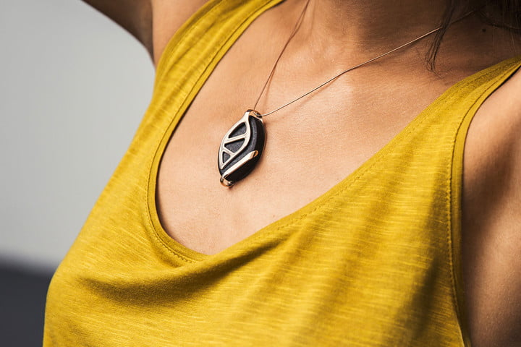
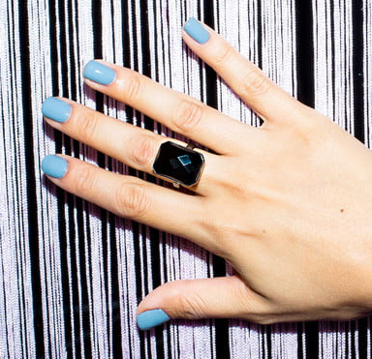
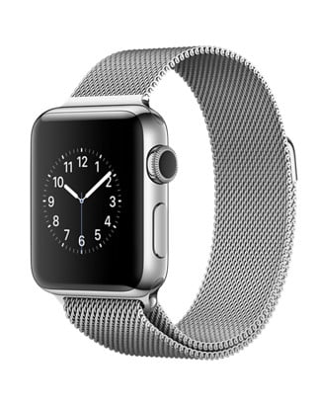
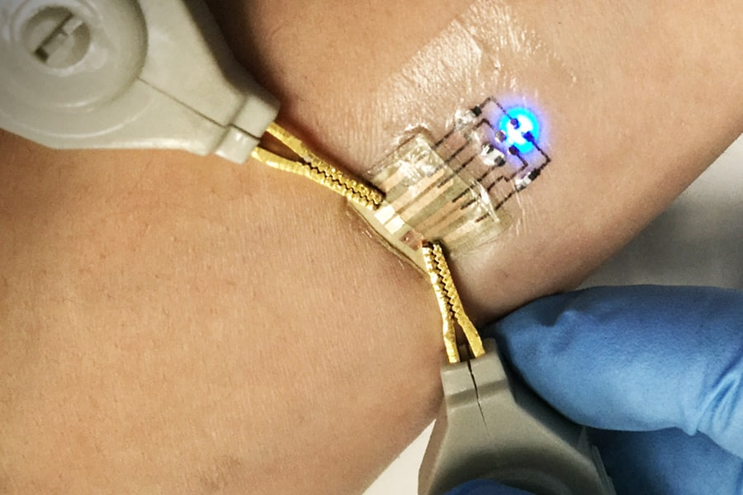
Other Examples

Slide 102
Research and Design
Considerations
Comfort
Needs to be light, small, not get in the way, fashionable, and preferably hidden in the clothing
Hygiene
Is it possible to wash or clean the clothing once worn?
Ease of wear
How easy is it to remove the electronic gadgetry and replace it?
Usability
How does the user control the devices that are embedded in the clothing?

Slide 103
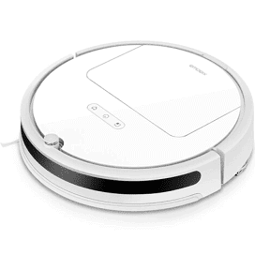
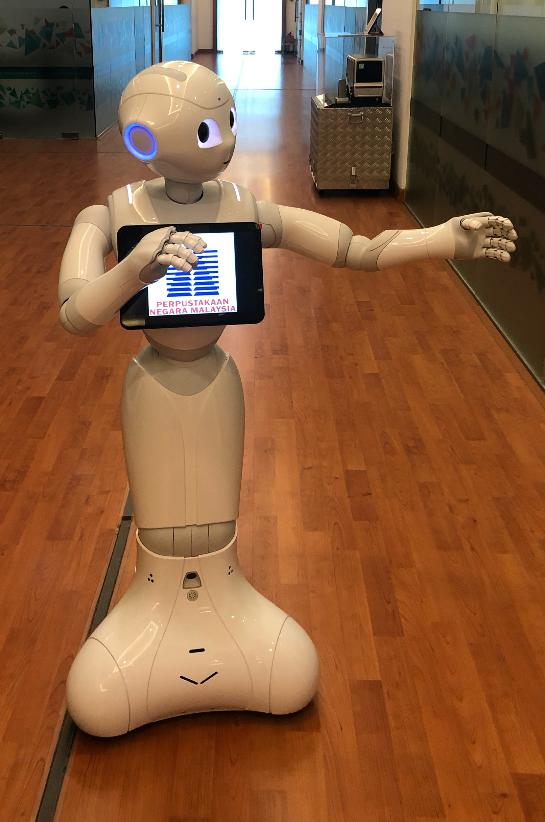
18. Robots …
Main types
Remote robots used in hazardous settings
Can be controlled to investigate bombs and other dangerous materials
Domestic robots helping around the house
Can pick up objects and do daily chores like vacuuming
Pet robots as human companions
Have therapeutic qualities, helping to reduce stress and loneliness
Sociable robots that work collaboratively with humans
Encourage social behaviors

Slide 104
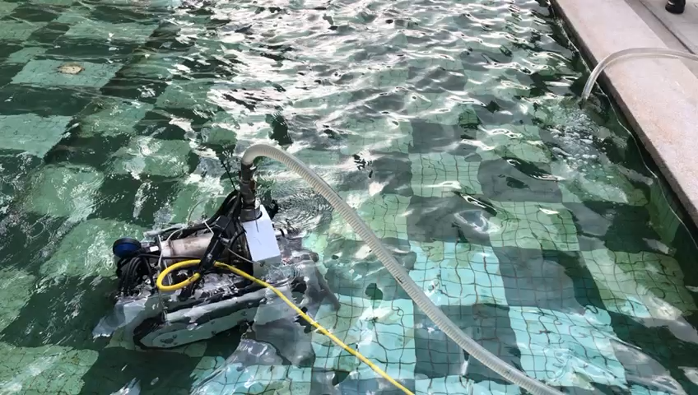
Cleaning Robot
UTM CAIRO: ROV Pleco to clean tank, pool

Slide 105
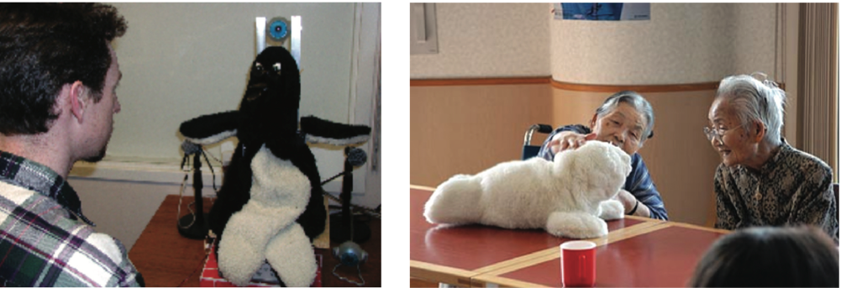
Social Robots: Mel and Paro
Cute and cuddly
Can open and close eyes and make sounds and movements
Source: Images courtesy of Mitsubishi Electric Research Labs.

Slide 106
18. … and Drones
Unmanned aircraft that are controlled remotely and used in a number of contexts
Medical supplies, groceries and carrying drinks and food to people at festivals and parties
Construction and agricultural applications, such as flying them over vineyards and fields to collect data about crops
Firework displays
Helping to track poachers in wildlife parks in Africa
Can fly low and and stream photos to a ground station where images can be stitched together into maps
Can be used to determine the health of a crop, or when it is the best time to harvest the crop

Slide 107
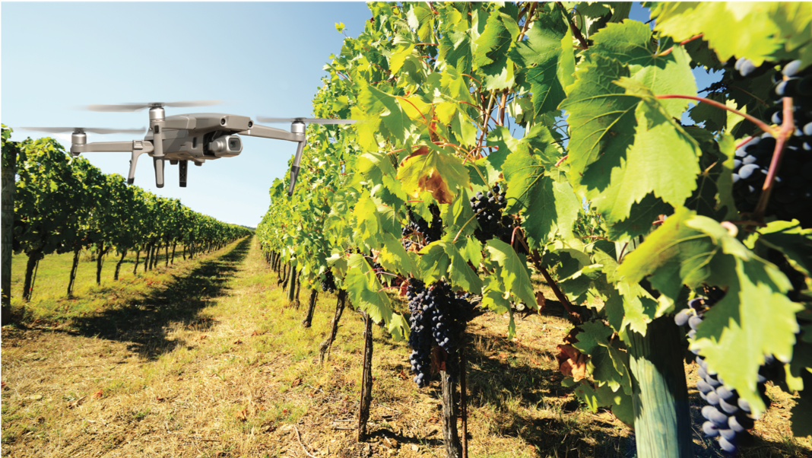
Drone being used to survey the state of a vineyard

Slide 108
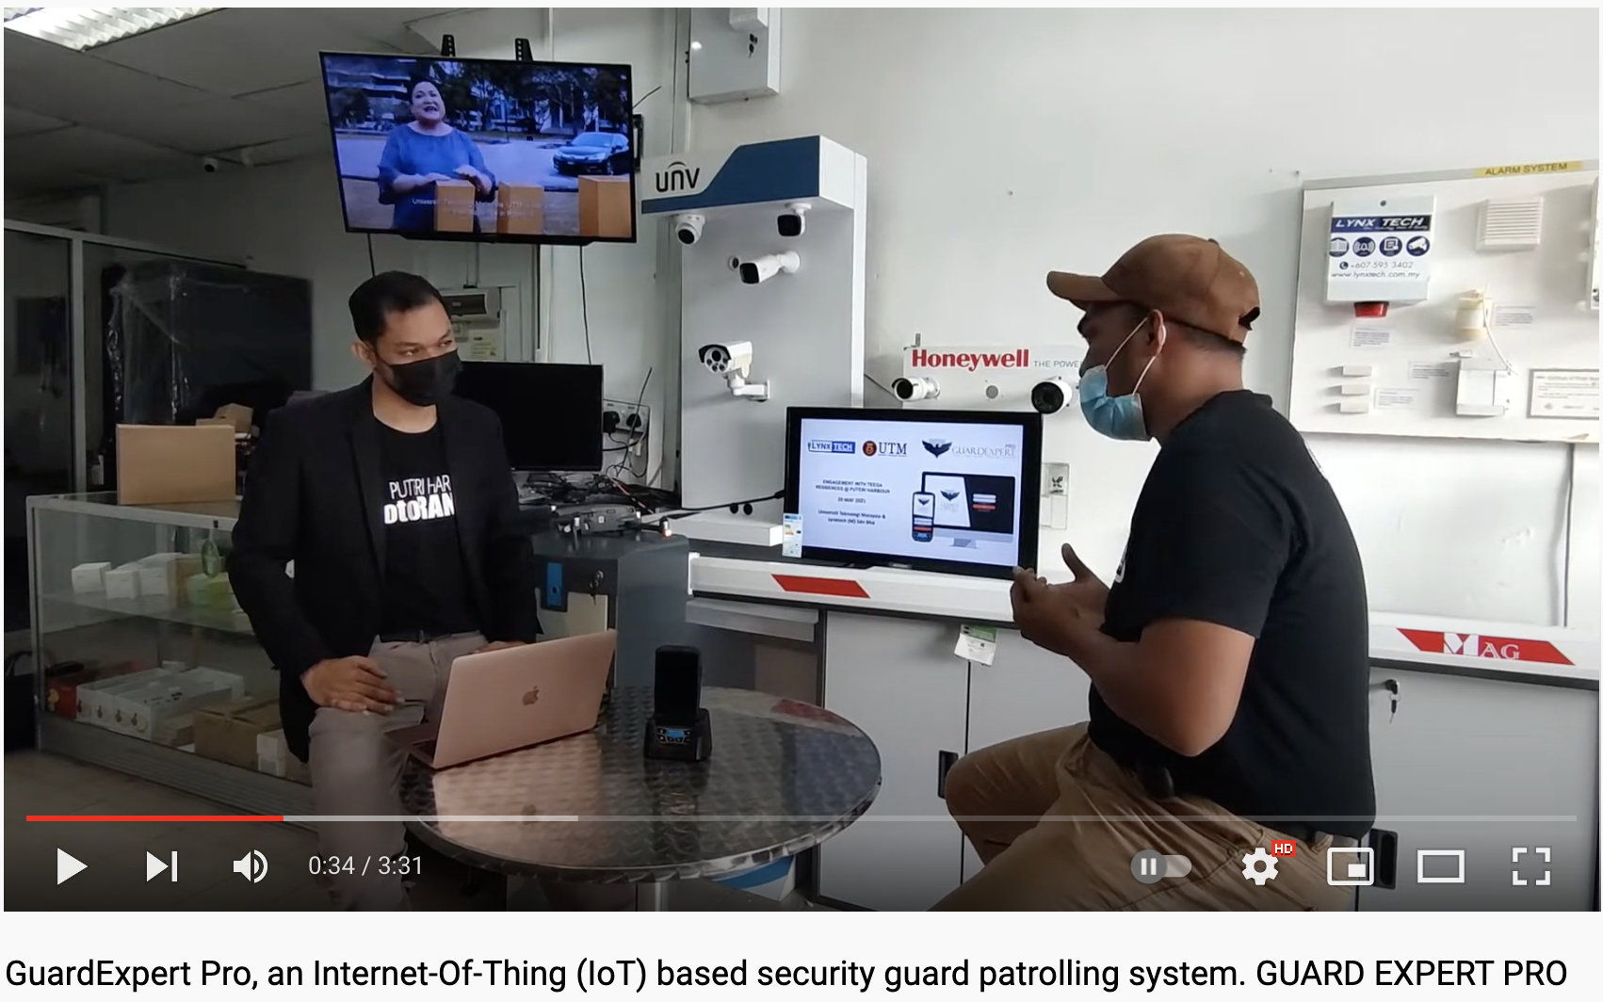
Drone to patrol surrounding

Slide 109
Research and Design
Considerations
How do humans react to physical robots designed to exhibit behaviors (for example, making facial expressions) compared with virtual ones?
Should robots be designed to be human-like or look like and behave like robots that serve a clearly-defined purpose?
Should the interaction be designed to enable people to interact with the robot as if it was another human being or more human-computer-like (for example, pressing buttons to issue commands)?
Is it acceptable to use unmanned drones to take a series of images or videos of fields, towns, and private property without permission or people knowing what is happening?

Slide 110
19. Brain-Computer Interfaces
Brain-computer interfaces (BCI) provide a communication pathway between a person’s brain waves and an external device, such as a cursor on a screen
Person is trained to concentrate on the task, for example, moving the cursor
BCIs work through detecting changes in the neural functioning in the brain
BCIs apps:
Games (for example, Brain Ball)
Enable people who are paralysed to control robots

Slide 111
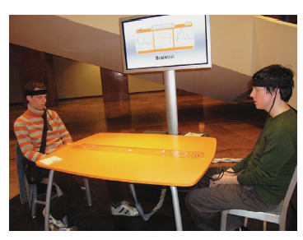
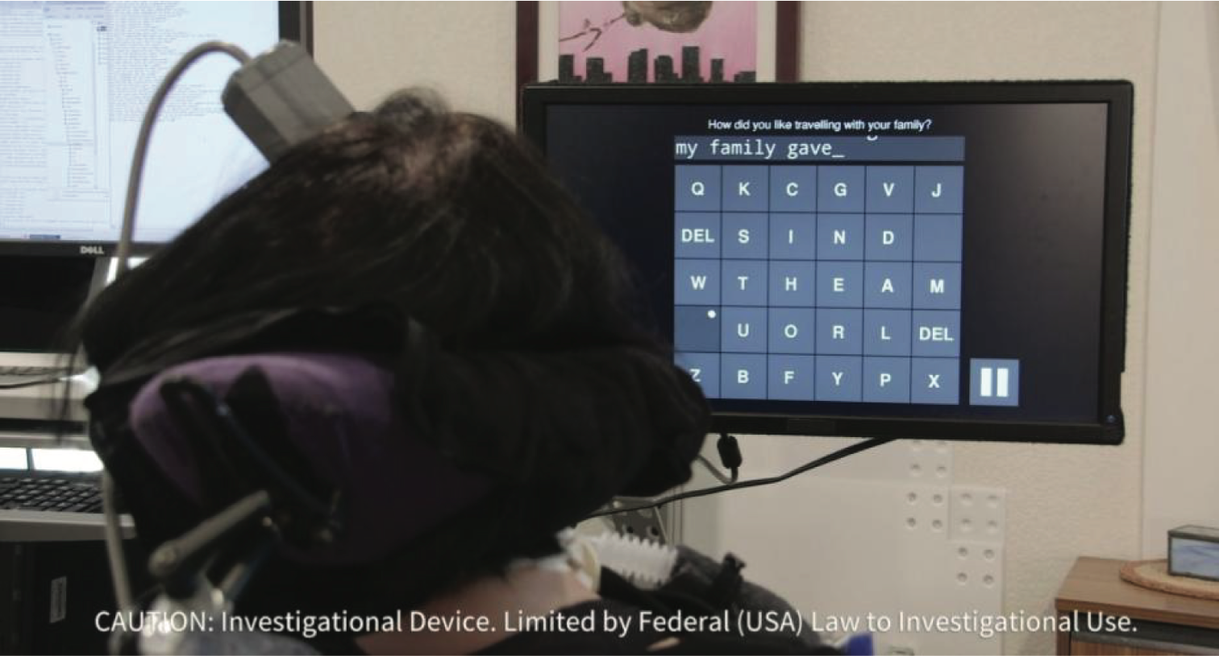
Examples
Brainball
A brain-computer interface being used by a woman who is paralyzed to select letters on the screen

Slide 112
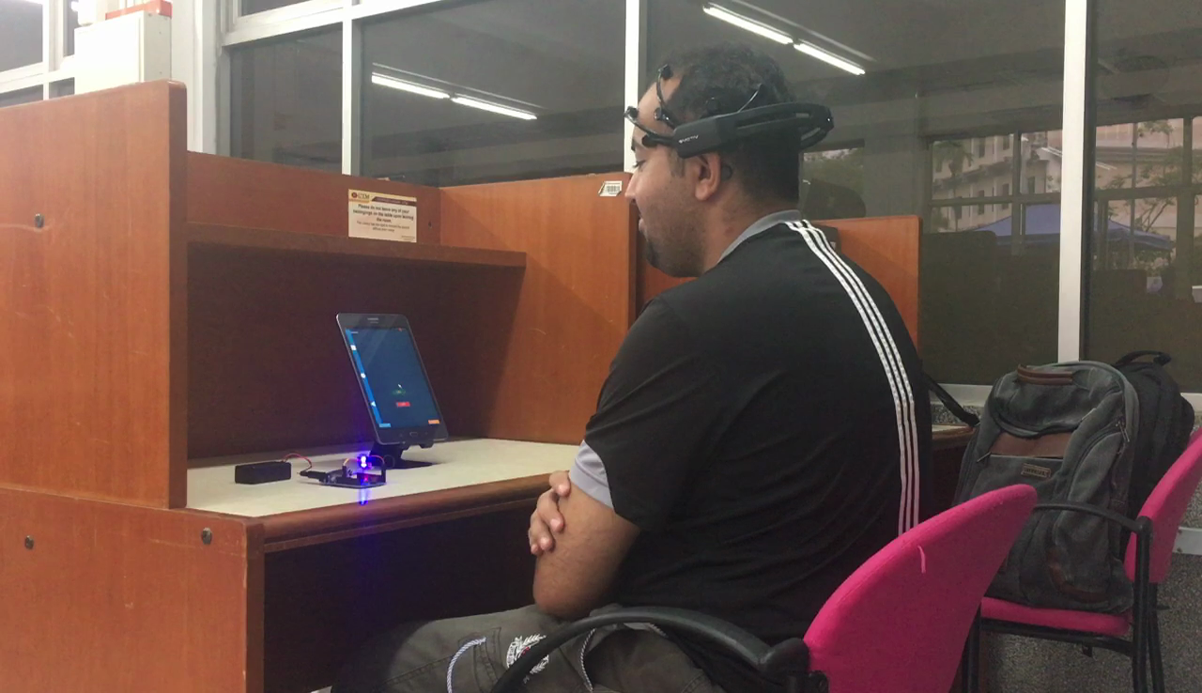
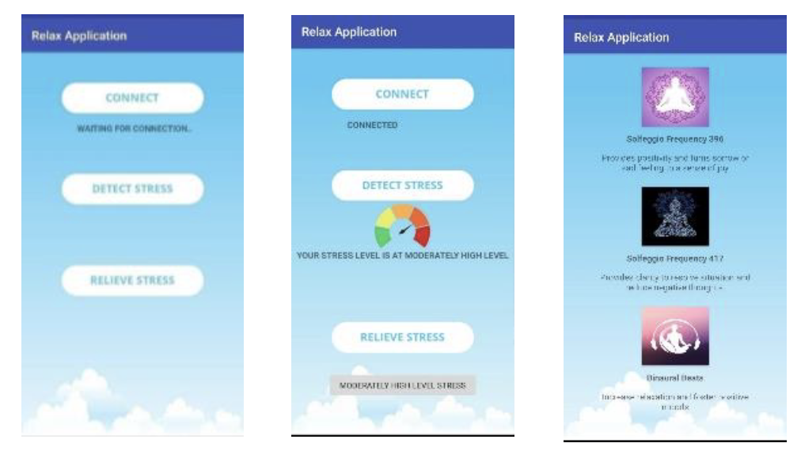
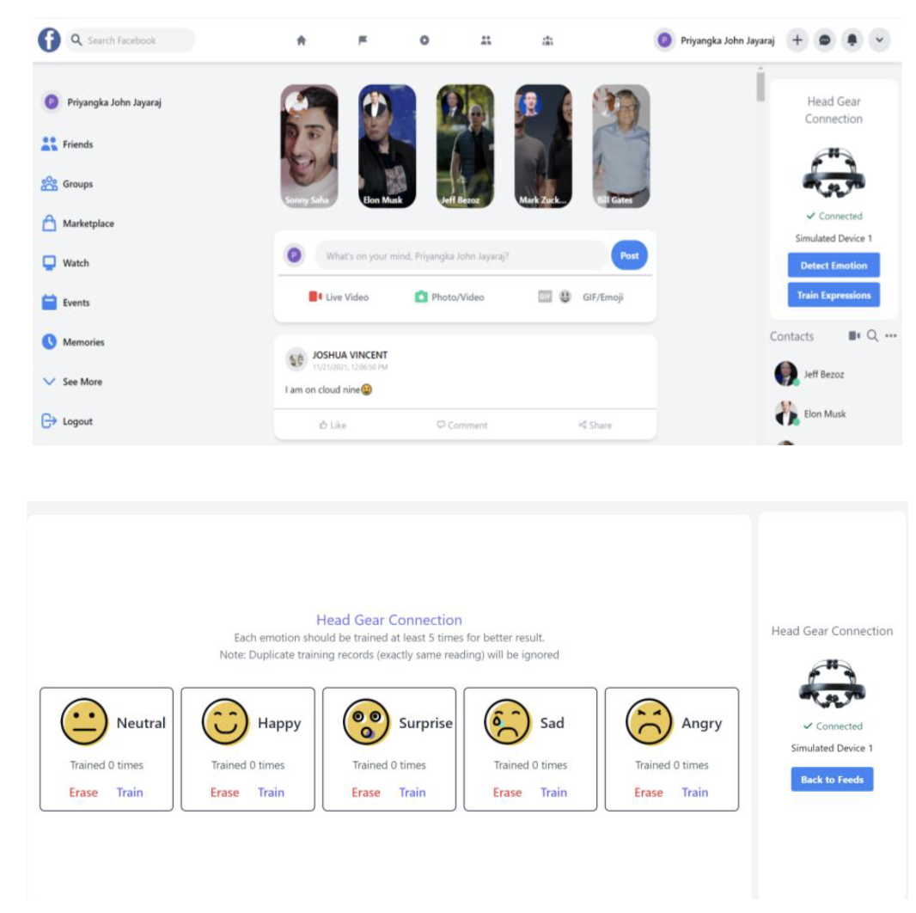
Other Examples
Using BCI to control and manipulate different types of mobile applications
Source: N.A.Iahad, A.B.G. Ahmed-Gaber, M. Ghazali. 2018. A Conceptual Model for Mobile Interaction using Brain Computer Interface. International Journal of Future Generation Communication & Networking (IJFGCN)
BCI to express emotions on social media platform
Source: P. J. Jayaraj and M. Ghazali. User’s Perspectives on Expressing Emotions on Social Media Platform with mobile Brain-Computer Interface. In Proceedings of 3rd Fusion Symposium 2021
Mobile BCI to reduce stress among students
Source: P.J. Jayaraj, M. Ghazali and A.Gaber. Relax: Mobile Brain-Computer Interface App to Reduce Stress among Students. In Special Proceedings of 5th Asian CHI Symposium 2021.

Slide 113
Research and Design
Considerations
What is the best way to lay out letters on a digital screen so that the target space for each letter is sufficiently wide enough to allow for it to be selected using BCI?
Ethical concerns are raised by brain-computer interfaces that are being developed to work out what someone is thinking
Our thoughts have always been private and making them interpretable by machines, which in turn could be accessed and read by other people, raises privacy concerns
How accurate is BCI in what it infers to be someone’s thoughts?

Slide 114
20. Smart Interfaces
Smart: phones, speakers, watches, cars, buildings, cites
Smart refers to having some intelligence and connected to the internet and other devices
Context-aware
Understand what is happening around them and execute appropriate actions, for example, a Nest thermostat
Human-building interaction
Buildings are designed to sense and act on behalf of the inhabitants but also allow them to have some control and interaction with the automated systems

Slide 115
Research and Design
Considerations
Much current research is concerned with human values, needs, and priorities when addressing people's interactions with smart environments
Do smart interfaces amplify our actions and remain attentive to our goals or are they becoming more autonomous?
Do we need new metaphors to make understanding and using smart interfaces easier?
What might these be?
Another approach is to imbue smart technologies, like speakers and robots, with personalities
Can promote user trust and acceptance

Slide 116
21. Shape Changing Interfaces
Use physical shape change as input and output to systems
e.g.physical 3D bar chart that is positioned in a grid where a matrix of 3D rods move up and down to convey changes in a digital dataset
These kinds of dynamic physical representations have been found to help people with visualisation tasks
Shape-changing interfaces have also been developed as a form of dynamic material to explore novel interaction possibilities.
Provide a different way of interacting with content compared with reading and touching digital displays

Slide 117
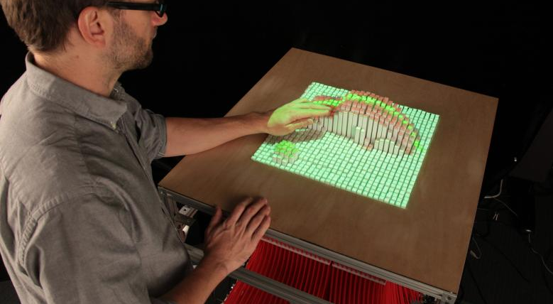
InFORM: a shape changing interface

Slide 118
Physicalisations
Physical artefacts that are designed to encode data in specific materials
An example is Physikit (Houben et al., 2016) which is a physical-digital system comprising a set of physical cubes that convey digital properties and are programmed to visualize real-time environmental data in the home
A main benefit is to make data more accessible and enable people to more readily connect with the context in which the data is being collected or is changing over time (Sauvé et al, 2022)

Slide 119
Research and Design
Considerations
Provide new opportunities for experiencing and exploring data using the sense of touch as well as sight
Does this facilitate enhanced understanding and engagement with a dataset?
Design considerations include what is the optimal size for a grid of physical rods and how many physicalisations to design in a set that people can learn and remember what they mean

Slide 120
22. Holographic Interfaces
Create the illusion of a 3D person being present through using various forms of trickery
Advances in projection and display technology have enabled these kinds of digital representations to appear quite convincing.
e.g. the Proto system lets people beam themselves to a remote location and interact with the people there
The show Abba Voyage, first launched in 2022 feature avatars (dubbed 'ABBAtars'), depicting the group as they appeared in the late 70s
The technology used includes a 65million pixel screen and in motion capture technology

Slide 121
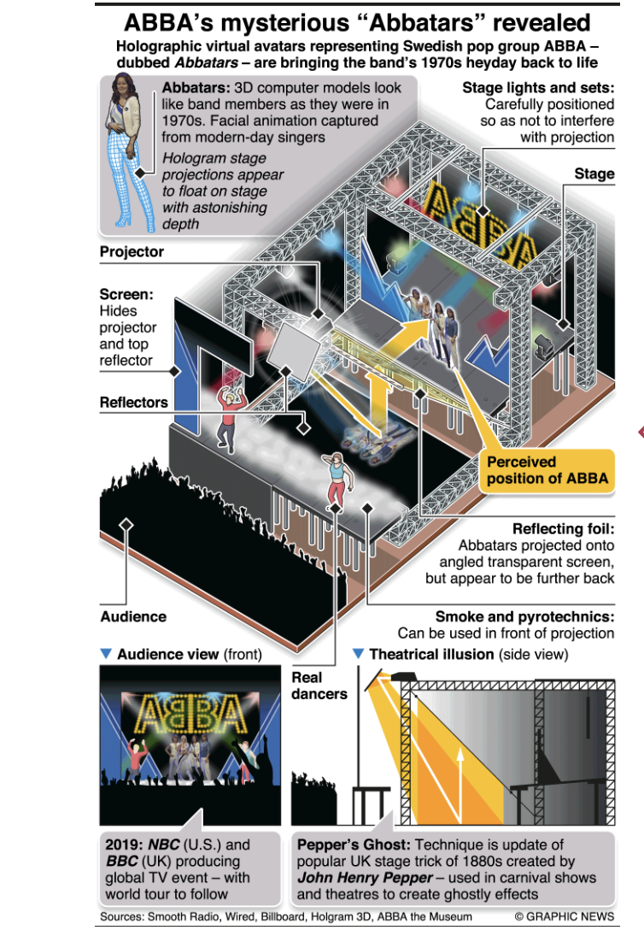
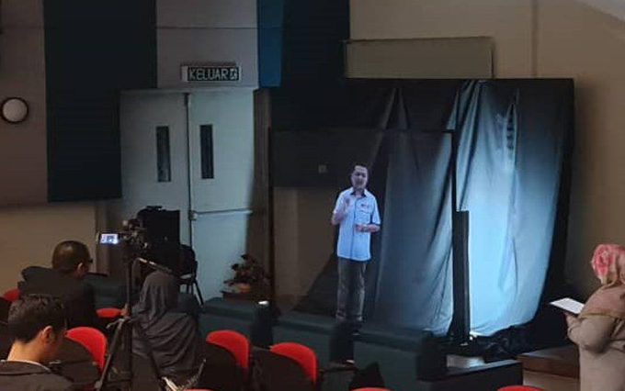
Examples
UTM’s Holo Professor
ABBA’s holographic projections

Slide 122
Research and Design
Considerations
What is the best way to represent people in virtual spaces so that they feel comfortable, are engaging to interact with, feel natural and do not appear creepy?
Design considerations include what size the holographs should be and how other’s viewing them can interact and communicate with those being projected into their space

Slide 123
NUI AND
BEYOND

Slide 124
From GUIs to Natural Interfaces
Interfaces have shifted from screen-based to more embodied, intuitive forms. NUIs aim to reduce the cognitive load by leveraging skills we already use in the real world.
Traditional interfaces from GUI → mobile → touch → wearables
Emerging trends include holographic and smart interfaces
Future direction requires more natural interactions
Natural User Interfaces (NUIs):
Interact using voice, hands, gestures, facial expressions
Aim to replicate real-world human interaction

Slide 125
The Challenges with Naturalness
Even 'natural' gestures can feel unnatural depending on context. Simplicity works best. More complex tasks may need a hybrid of natural and traditional inputs.
NUIs should be intuitive—but context matters:
Is it easier to say 'open' or flick a switch?
Raising arms to change a TV channel vs pressing a button
Don Norman’s naturalness depends on:
Required learning
Task complexity
Need for speed & precision
Example: sensor-based faucets work well with limited functions
But complex gestures for flow/temp? Less intuitive

Slide 126
Beyond Natural: Smart, Inclusive, Adaptive
Interfaces of the future won’t just be natural—they’ll be smart, inclusive, and adaptive.
Gestural/voice interfaces enhance accessibility
e.g., iPhone VoiceOver for visually impaired
Brain-Computer Interfaces (BCIs): powerful but unnatural
Require significant training
Combining sensors (brain, body, environment) enables:
Real-time emotional/cognitive adaptation
Continuous & discrete inputs
Merging sensor tech with AI opens up entirely new possibilities for human-computer collaboration.
AI empowers systems to collaborate with users

Slide 127
WHICH
INTERFACE?

Slide 128
Which Interface?
Which interface to use will depend on task, users, context, cost, robustness, and so on
Is multimedia better than tangible interfaces for learning?
Is speech as effective as a command-based interface?
Is a multimodal interface more effective than a mono-modal interface?
Will wearable interfaces be better than mobile interfaces for helping people to find information in foreign cities?
Are virtual environments the ultimate interface for playing games?
Are shareable interfaces better at supporting communication and collaboration compared with using networked desktop PCs?

Slide 129
Summary
Many innovative interfaces have emerged in the last 30 years, including speech, wearable, mobile, brain, and tangible
This raises many design and research questions as to decide which to use
For example, how best to represent information to the user so that they can carry out ongoing activity or task
New smart interfaces that are context-aware and monitor people
Raising new ethical issues concerned with what data is being collected and what it is used for

Slide 130
In-depth Activity
Choose a game that you or someone you know plays a lot on a smartphone (for example, Candy Crush Saga, Fortnite, or Minecraft). Consider how the game could be played using different interfaces other than the smartphone’s. Select three different interfaces (for instance, tangible, wearable, and smart speaker) and describe how the game could be redesigned for each of these, taking into account the user group being targeted. For example, the tangible game could be designed for children, the wearable interface for young adults, and the smart speaker for visually impaired people.
Go through the research and design considerations for each interface and consider whether they are relevant for the game setting and what considerations they raise.
Describe a hypothetical scenario of how the game would be played for each of the three interfaces.
Consider specific design issues that will need to be addressed. For example, how will the players interact with the game elements for each of the different interfaces—by using a pen, fingertips, voice, or other input device? How do you turn a single-player game into a multiple player one? What rules would you need to add?
Compare the pros and cons of designing the game using the three different interfaces with respect to how it is played on the smartphone.

